Slide 1
Scrum Team Names
Scrum team names from previous semesters:
EZScrumEZGo
SourPatchEngineers
DreamRaccoons
TeamFun
SwagMoney
MonaLisas
Scrumdiddlyumptious
FightingBass
TitanicSwimTeam
GloriousKenobis
RedDragons
ScrumciousCoders
Mongooses
Scrumples
WubbaLubbaDubDubs
RedPandas
SpiderScrum
MadSanitizers
SpeedCoders
StingyTadpoles
BlueThrees
PurpleCobras
ScruptyDupty
LaughableCaterpillars
PurplePirates
ScrumIsFum
ScrummyScrumbags
TheCrew
WickedCrew
SpicyChalupa
ScrumOfTheEarth
LightningMcQueen
Notes:
Hand out name tags and introduction forms before Syllabus Overview

Slide 2
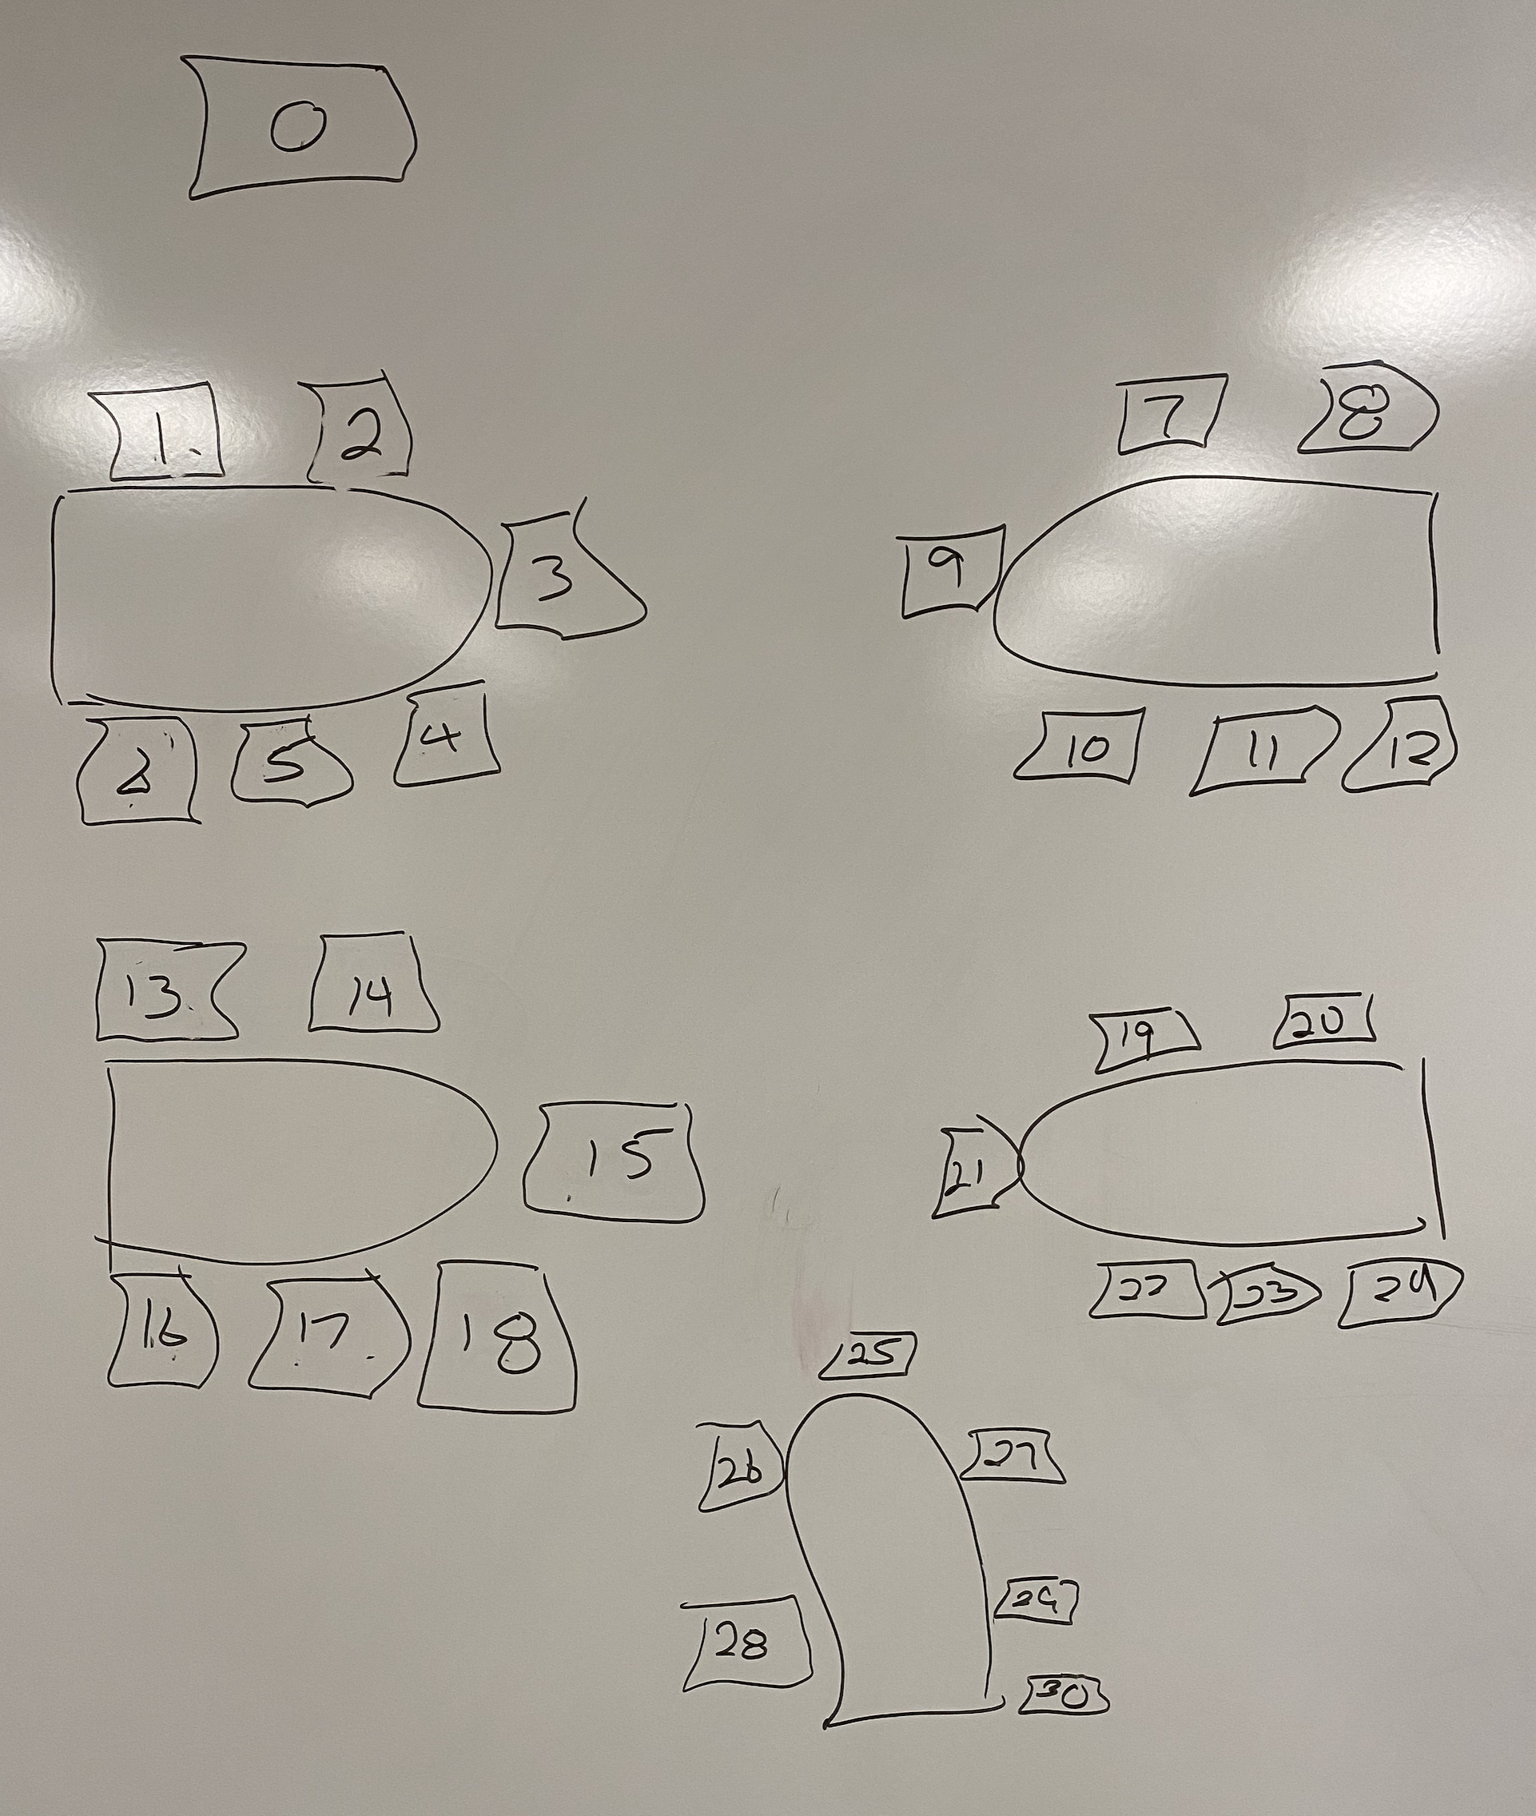
Your Introductions
Be prepared to share your:
Full & Preferred Name
Seat Number and Row in spreadsheet
Major / Minor
Programming Experience (1 to 5)
An interesting fun fact about yourself
Favorite “adjective/noun” scrum team name
Are you willing to be your team’s initial Scrum Master?

